Slide 1
Match-amials
From team (blank)
Class

Slide 2
Concept
Market: Children 10 and under
Alignment:Educational
Mood:Fun
Pace:Slow
What:
Why:
Where:

Slide 3
Concept
Risks:
Organization:
Potential Tools:

Slide 4
Research Questions
Project Title
Team Names
Date
User Story(“As a x, Want to Y,so that I can accomplish Z) |  | Proposed method | Difficulty to build | Estimated Time | Expected results | Fidelity/accuracy to final product recommendation
As a player I want to be able to draw connections to answer puzzle questions. |  | Implement keyboard control for mobile devices |  |  | Player can choose their answer by drawing on screen. Wrong answer will reset the drawing, correct answer will initiate a correct prompt. | Very important
As a player I want to be able to solve math questions in a fun manner for a reward. |  | Implement keyboard control for mobile devices |  |  | Player can solve the equation by dragging the correct number into the equation. Wrong answers will cause the correct number to light up. | Very important
As a player I want to be able to solve word puzzle by filling in the missing words. |  | Implement keyboard control for mobile devices |  |  | Player can solve word puzzle by dragging the right letter, the word will refresh and fill in one of the missing letters on a failed attempt. | Very important

Slide 5
Change Log
Build | Build Issues/Test Notes | Changes/Solutions

Slide 6
Change Log
Build | Build Issues/Test Notes | Changes/Solutions

Slide 7
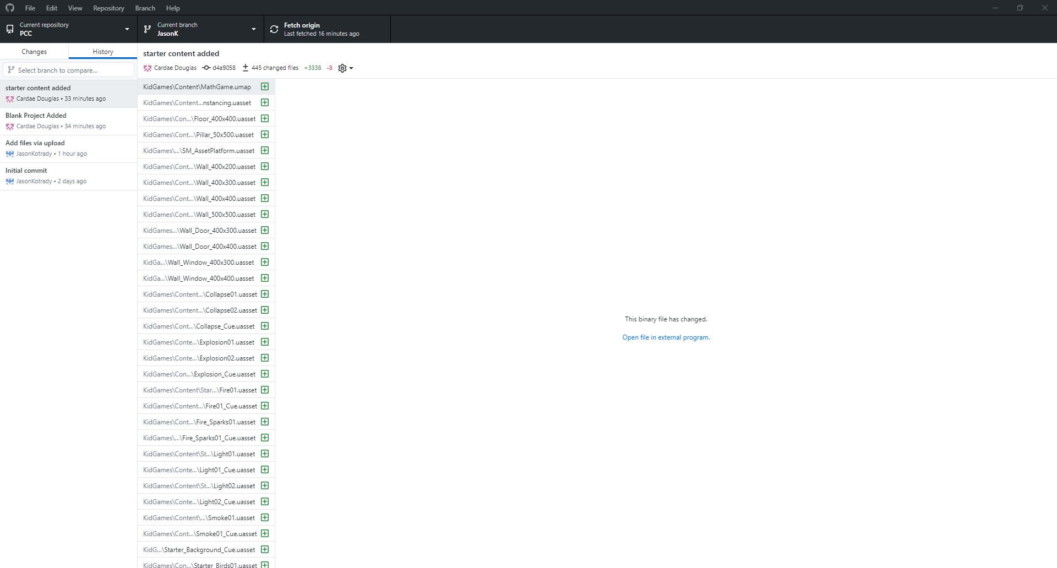
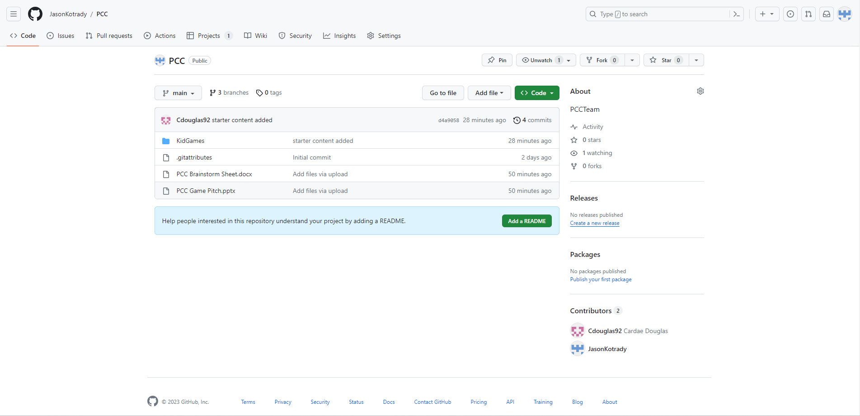
GIT HUBs
Desktop
Web

